Slide 1
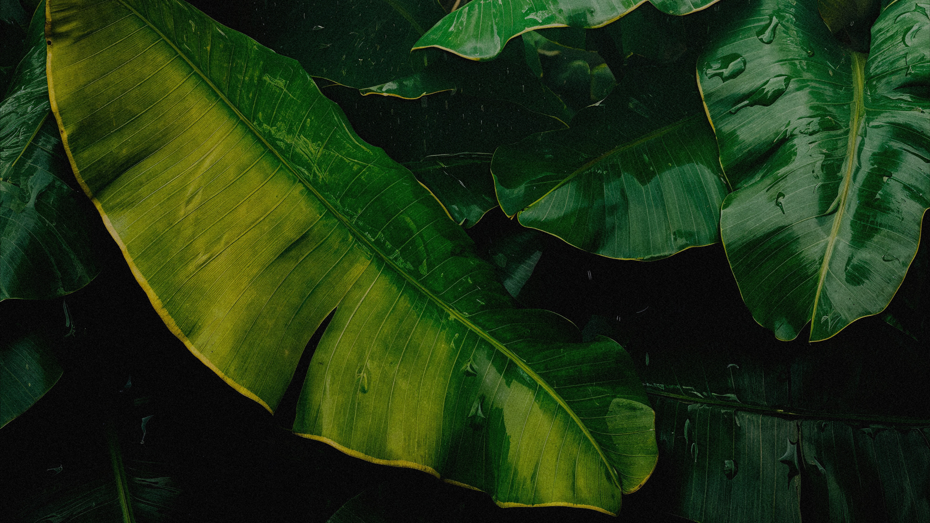
VIBRANT GREEN LEAVES
FRESH
WILD
DEEP
Here is
where your presentation
begins.

Slide 2

CONTENTS OF THIS TEMPLATE
Fonts
Colors
Thanks slide
Icons and infographics
To view this template correctly in PowerPoint, download and install the fonts we used
You can see on the link all the colors used in this presentation
You must keep it so that proper credits for our design are given
These can be used in the template, and their size and color can be edited
For more info: SLIDESGO | SLIDESGO AI TOOLS | BLOG | FAQs
You can edit the master slides easily. For more info, click here
You can delete this slide when you’re done editing the presentation
You can visit our sister projects: FREEPIK AI TOOLS | FREEPIK LIBRARY RESOURCES

Slide 3
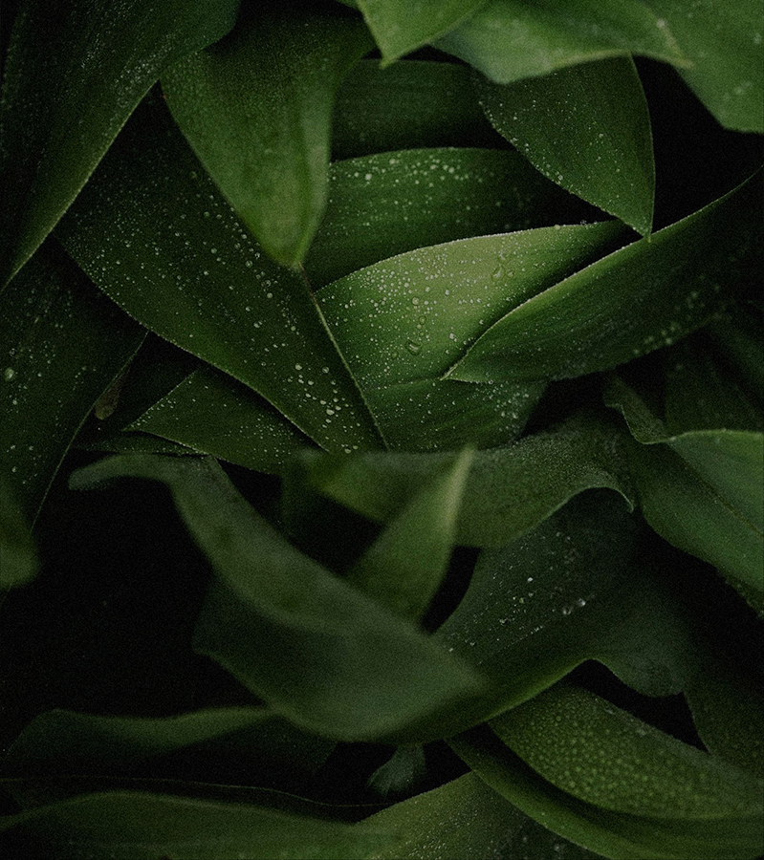
01
02
03
04
TABLE OF CONTENTS
05
06
07
08
Name of the section
Name of the section
Name of the section
Name of the section
Name of the section
Name of the section
Name of the section
Name of the section

Slide 4
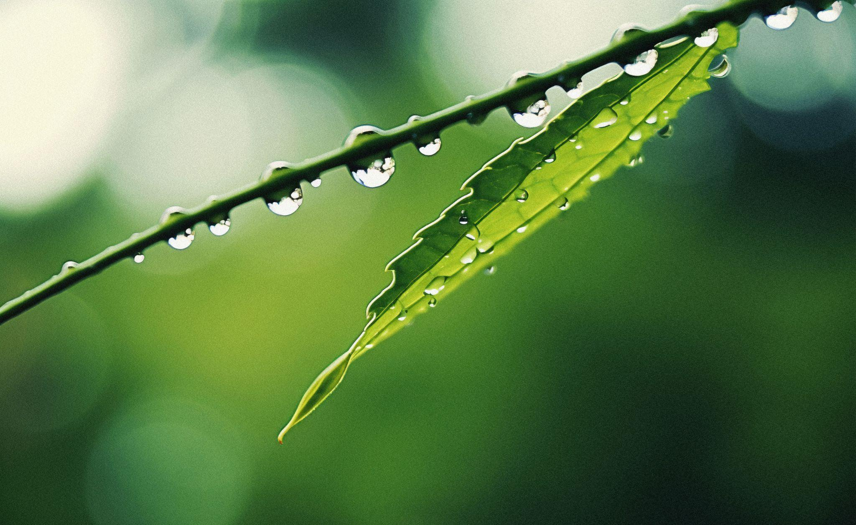
YOU CAN WRITE
HERE YOUR TITLE
Mercury is the closest planet to the Sun and the smallest one in the entire Solar System. This planet’s name has nothing to do with the liquid metal, since Despite being closer to the Sun than Venus, its temperatures aren't as terribly hot as that planet’s. Its surface is quite similar to that of Earth’s Moon, which means there are a lot of craters and plains.

Slide 5
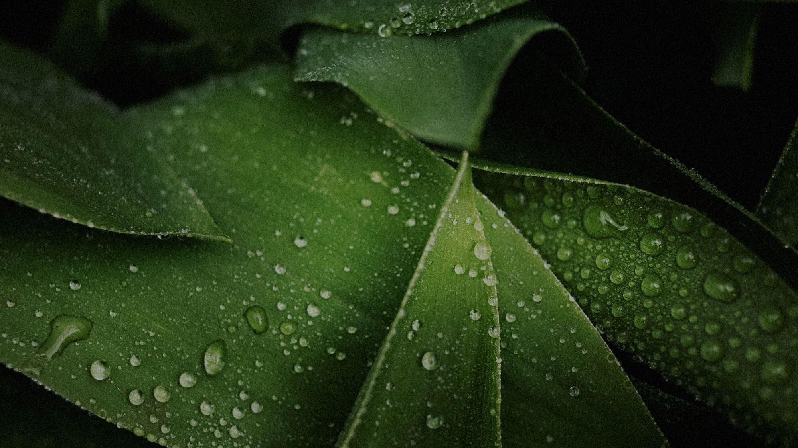
NAME OF THE SECTION
01
PURE
GLOW
CALM

Slide 6
LET’S HAVE A LOOK
Mercury is the closest planet to the Sun and the smallest one in the entire Solar System. This planet’s name has nothing to do with the liquid metal, since Mercury was named after the Roman messenger god. Despite being closer to the Sun than Venus, its temperatures aren't as terribly hot as that planet’s. Its surface is quite similar to that of Earth’s Moon, which means there are a lot of craters and plains. Speaking of craters, many of them were named after artists or authors who made significant contributions to their respective fields. Mercury takes a little more than 58 days to complete its rotation, so try to imagine how long days must be there!

Slide 7
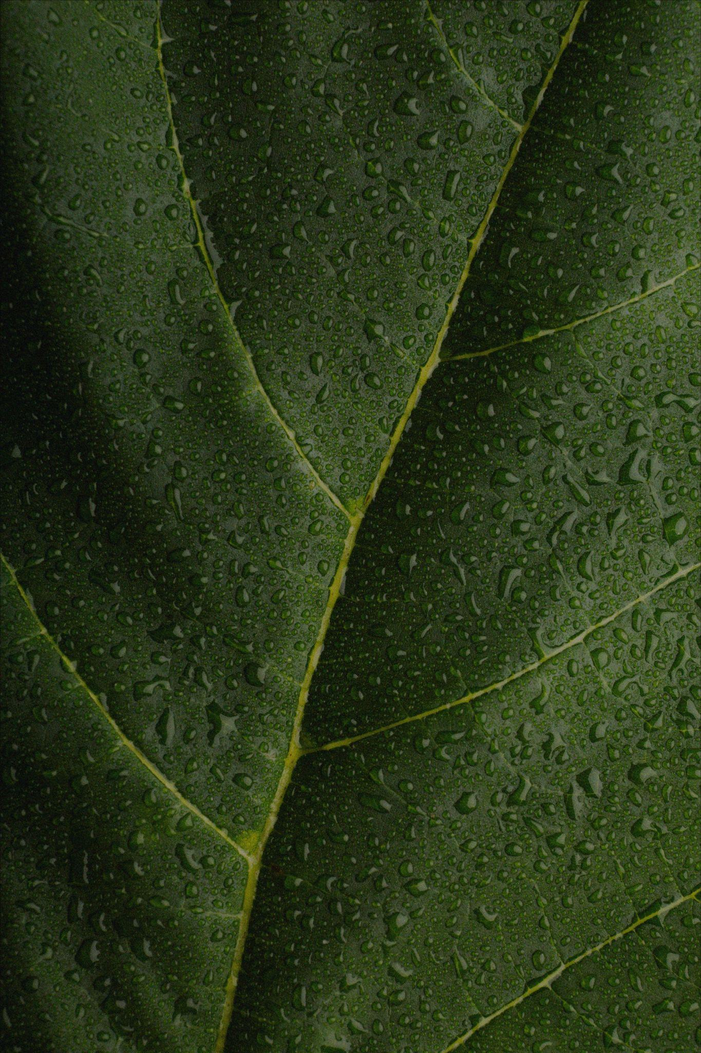
TWO IDEAS
LET’S LEARN ABOUT MERCURY
Mercury is the closest planet to the Sun and the smallest one in the Solar System. This planet’s name has nothing to do with the liquid metal.
LET’S TAKE A LOOK AT VENUS
Venus has a beautiful name and is the second planet from the Sun. It’s hot and is the second-brightest natural object in the night sky.

Slide 8
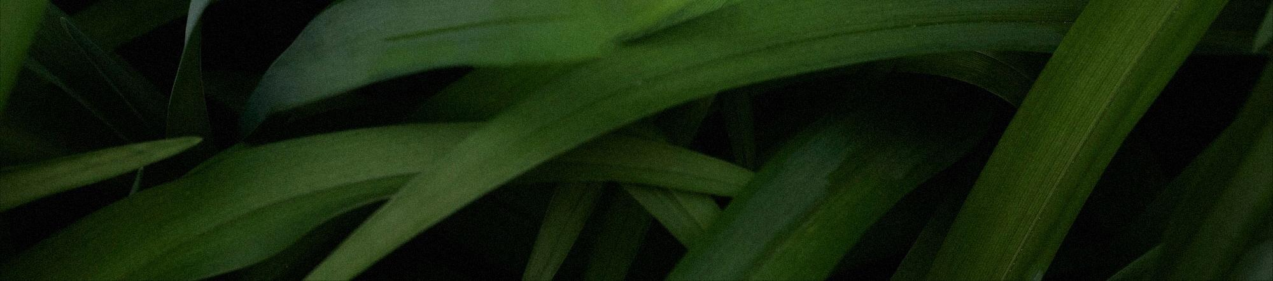
01
02
03
THESE ARE THREE
KEY IDEAS
Mercury is the closest planet to the Sun and the smallest one in the Solar System. This planet’s name has nothing to do with the liquid metal, since Mercury was named after the Roman messenger god.
Venus has a beautiful name, it is hot and is the second planet from the Sun. Its atmosphere is extremely poisonous. It’s the second-brightest natural object in the night sky after the Moon.
Jupiter is the fourth-brightest object in the night sky and it has around eighty moons. It was named after the Roman god of the skies and is the biggest planet in the entire Solar System.

Slide 9
LET’S REVIEW THESE SIX IDEAS
01
04
02
05
03
06
Mercury is the smallest planet of them all, even smaller than some of the moons of other planets.
Jupiter, the largest planet in the Solar System, is a gas giant. It ranks as the fourth-brightest object in the night sky.
Despite its red appearance, Mars is actually a cold planet. The surface is covered in iron oxide dust.
Saturn is primarily composed of hydrogen and helium, making it a massive gas giant.
Venus has a beautiful name and is the second planet from the Sun. Its atmosphere is extremely poisonous.
Neptune is the farthest planet from the Sun in our Solar System. It’s known for its deep blue color.

Slide 10
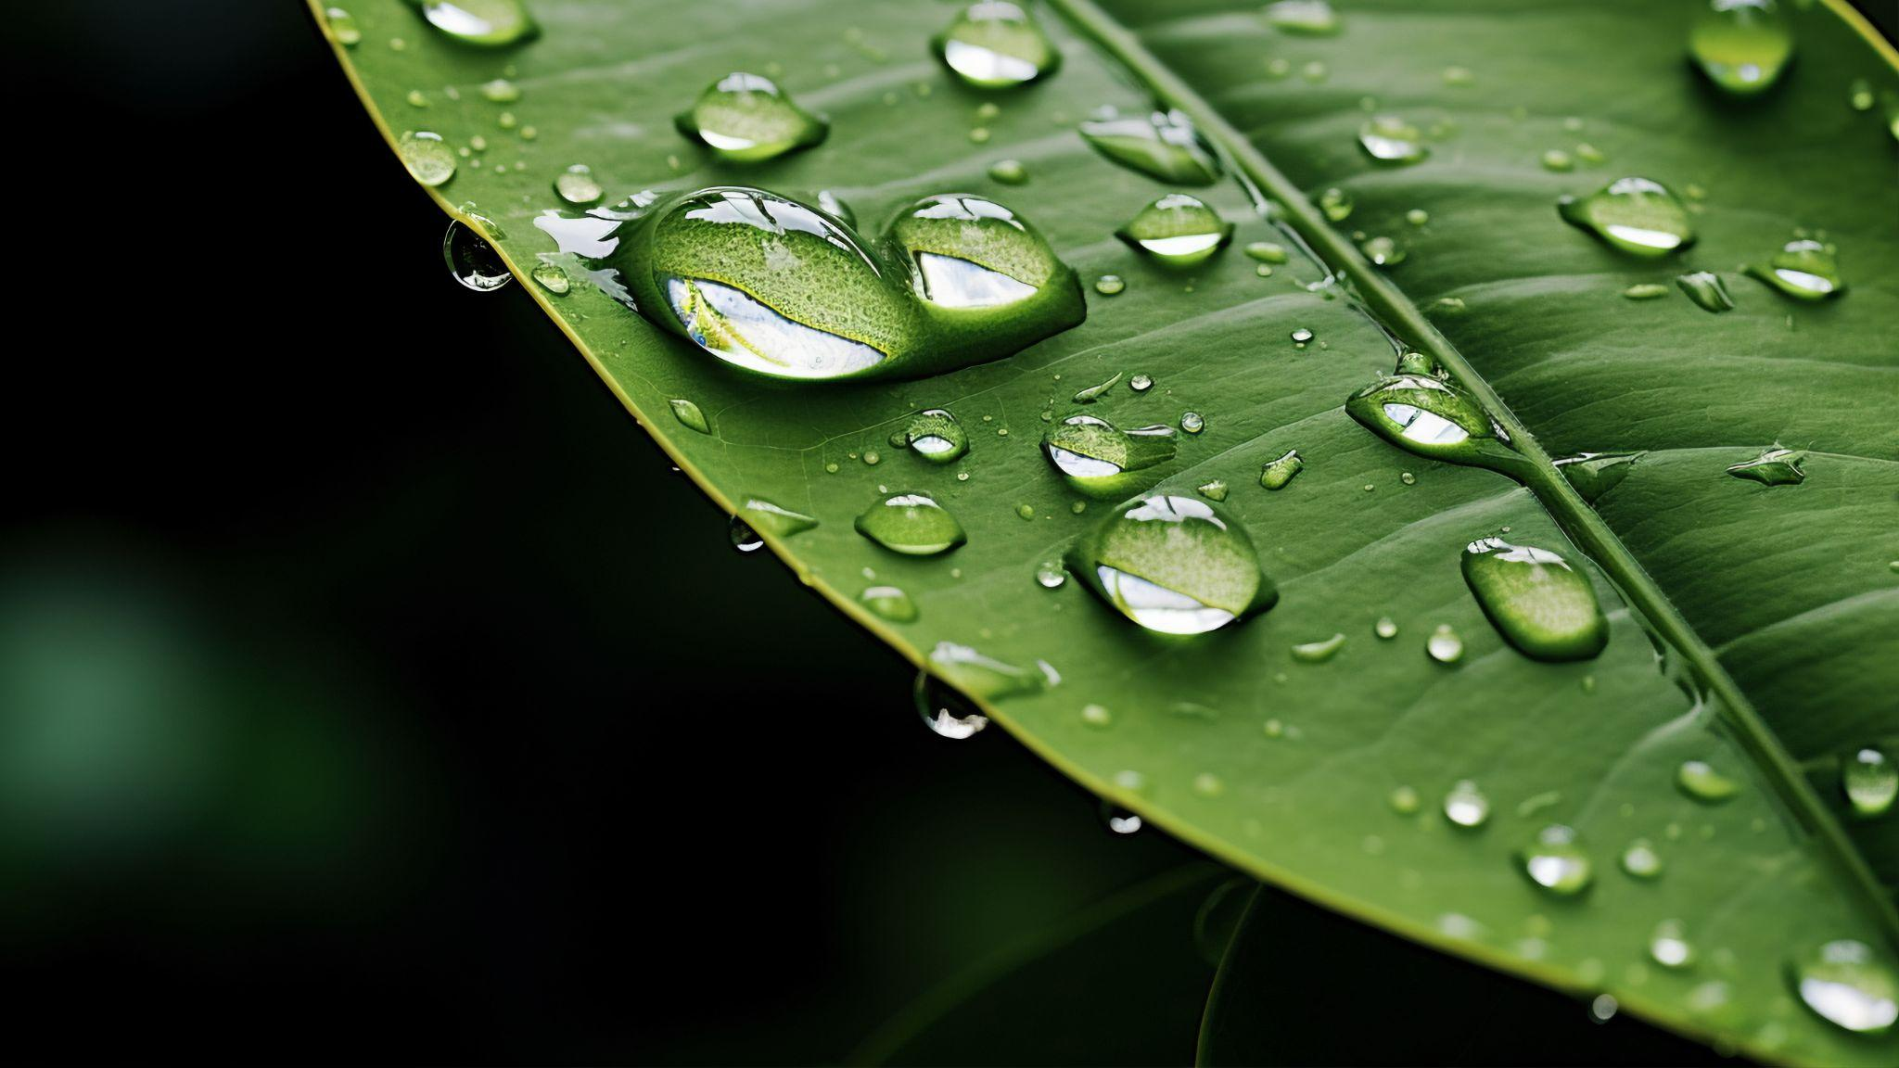
A PICTURE IS WORTH A THOUSAND WORDS

Slide 11
THIS IS A TIMELINE
Mercury is the smallest planet in the Solar System.
Venus is the second planet from the Sun.
Earth is the third planet from the Sun and has life.
Despite being red, Mars is actually a very cold place.
Jupiter is the fourth-brightest object in the sky.
MERCURY
VENUS
EARTH
MARS
JUPITER
“Saturn is a gas giant and has several rings. It’s composed mostly of hydrogen and helium”

Slide 12
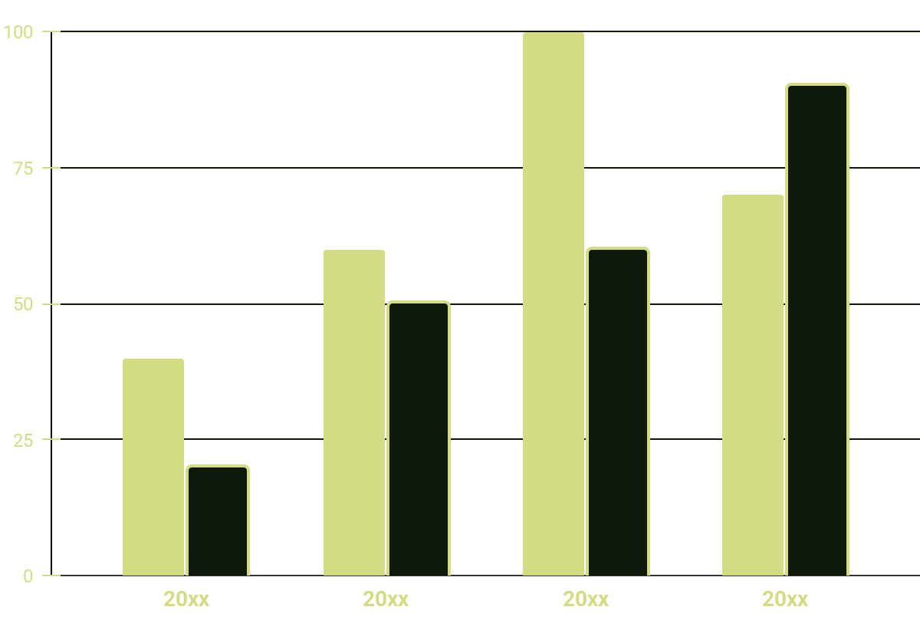
REPRESENT YOUR DATA HERE
YEAR | VENUS | MARS
20xx | $0.30 | $31.90
20xx | $3.90 | $15.40
20xx | $157.30 | $492.80
20xx | $3,368.20 | $13,929.80
THIS IS MARS
THIS IS NEPTUNE
Follow the link in the graph to modify its data and then paste the new one here. For more info, click here
Despite being red, Mars is a cold place.
Neptune is far away from the Sun.

Slide 13
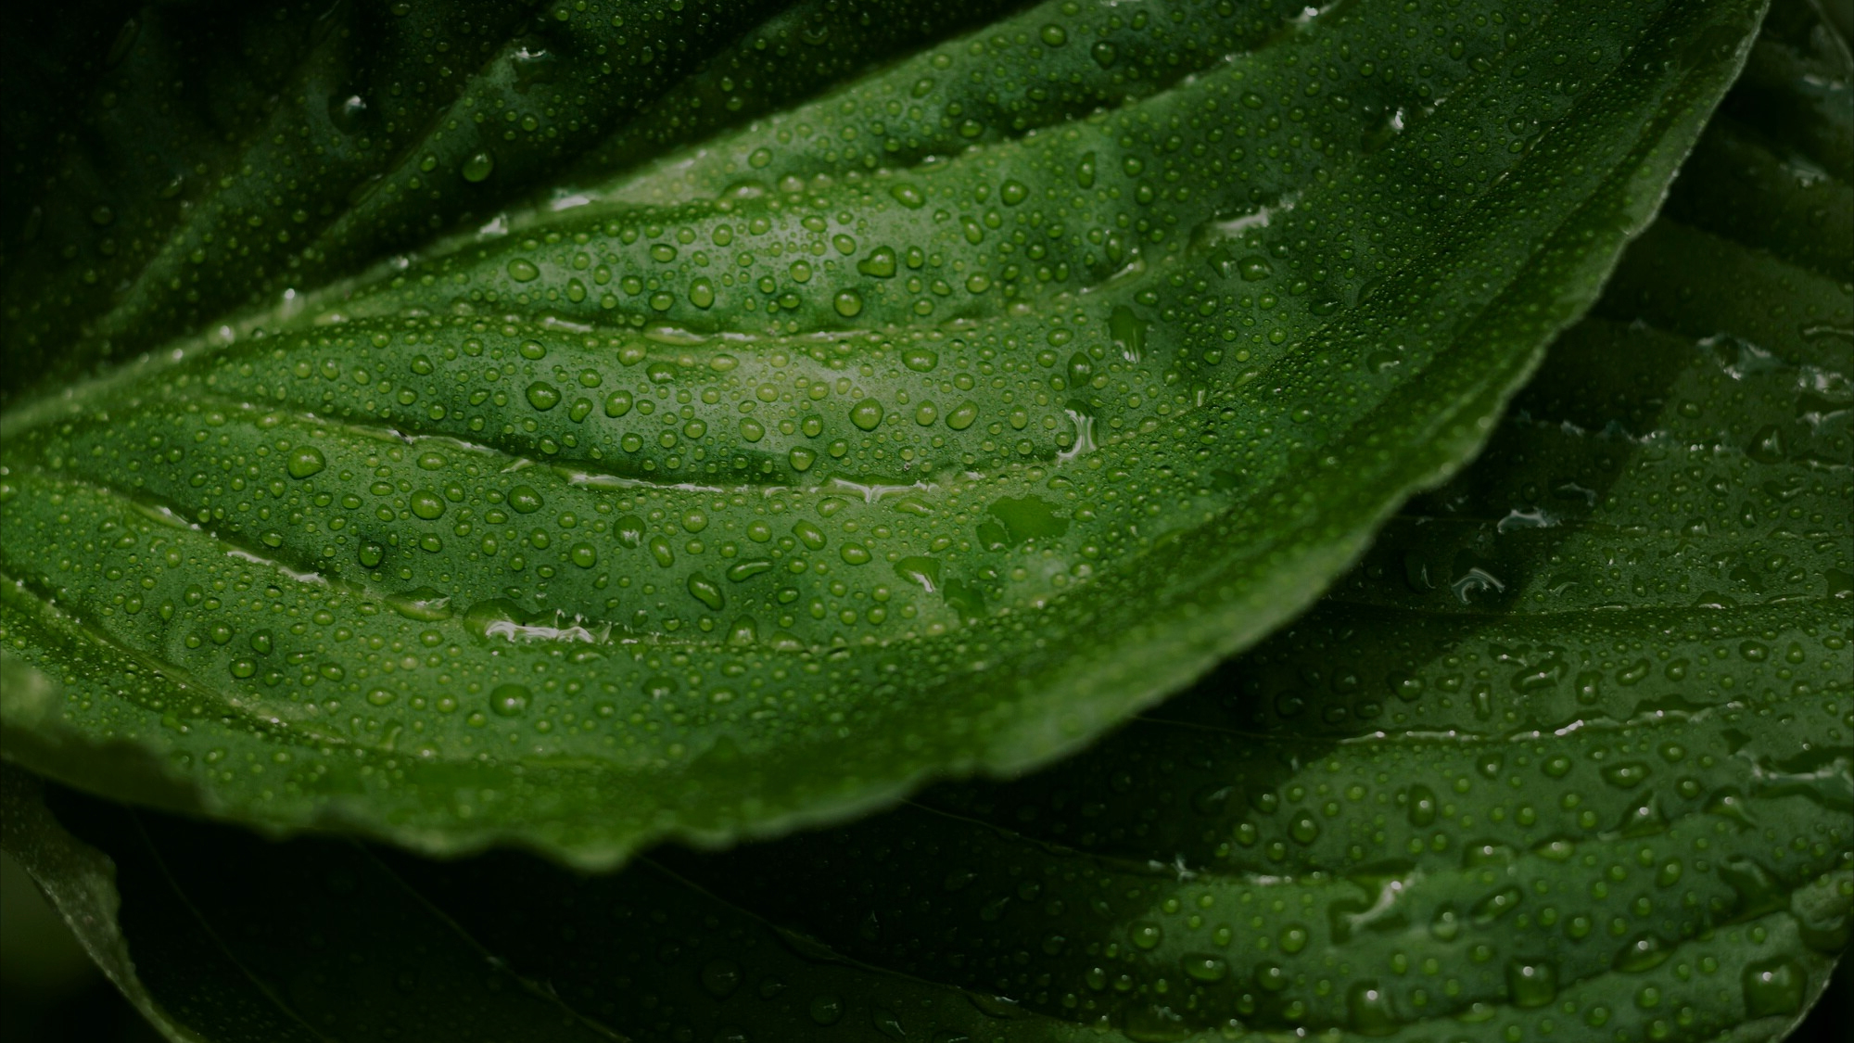
OUR NUMBERS
333,000
386,000 KM
BLOOM
LUSH
BRIGHT
The Sun’s mass compared to Earth’s.
Distance between Earth and the Moon.

Slide 14
THANK YOU
DO YOU HAVE ANY QUESTIONS?
youremail@freepik.com
+00 000 000 000
yourwebsite.com
Please keep this slide for attribution

Slide 15
Instructions for use
If you have a free account, in order to use this template, you must credit Slidesgo by keeping the Thanks slide
As a Free user, you are allowed to:
Modify this template
Use it for both personal and commercial projects
You are not allowed to:
Sublicense, sell or rent any of Slidesgo Content
Distribute Slidesgo Content unless it has been expressly authorized by Slidesgo
Include Slidesgo Content in an online or offline database or file
Offer Slidesgo templates (or modified versions of Slidesgo templates) for download
Acquire the copyright of
Slidesgo Content
For more information about editing slides, please read our FAQs or visit our blog

Slide 16
Instructions for use (premium users)
As a Premium user, you can use this template without attributing Slidesgo or keeping the Thanks slide
You are allowed to:
Modify this template
Use it for both personal and commercial projects
Share this template in an
editable format
Hide or delete the “Thanks” slide and the mention to Slidesgo in the credits
You are not allowed to:
Sublicense, sell or rent any of Slidesgo Content
Distribute Slidesgo Content unless it has been expressly authorized by Slidesgo
Use any of the elements that are part in a separated way
Register any of the elements as a trademark or logo in an intellectual property registry
For more information about editing slides, please read our FAQs or visit our blog

Slide 17
Fonts
Colors
This presentation has been made using the following fonts:
All the colors used in this presentation
Click on the button of the link to the fonts
#d3dc84
#0e190b
#d3dc84
Savate
#0e190b
Work Sans
To view this template correctly in PowerPoint, download and install the fonts we used

Slide 18
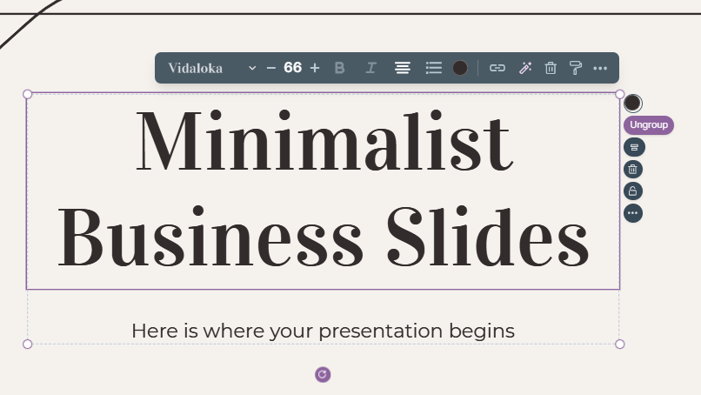
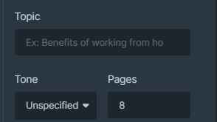
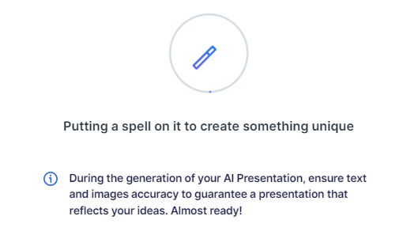
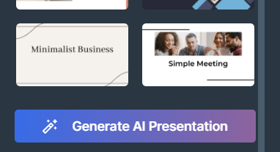
Presentation Maker
Slidesgo introduces its latest feature: the Presentation Maker. Enjoy two main functionalities - firstly, with a few clicks, create marvelous presentations with Artificial Intelligence that adapt to your needs. And it's completely free
Generate AI Presentation

Slide 19
Use our editable graphic resources...
You can easily resize these resources without losing quality. To change the color, just ungroup the resource and click on the object you want to change. You can also look for more infographics on Slidesgo

Slide 22
 | Jan | Feb | Mar | Apr | Jun
Task 1
Task 2
Task 3
 | No | Yes | Yes | No | Yes
 | Yes | No | Yes | No | Yes
 | Yes | Yes | No | Yes | No
 | Jan | Feb | Mar | Apr | Jun
Task 1
Task 2
Task 3

Slide 24
6/10 | 8/10 | 7/10 | 4/10

Slide 25
...and our sets of editable icons
You can resize these icons without losing quality
You can change the stroke and fill color; just select the icon and click on the paint bucket/pen
In Google Slides, you can also use Flaticon’s extension, allowing you to customize and add even more icons

Slide 26
Educational icons
Medical icons

Slide 27
Business icons
Teamwork icons

Slide 28
Help & support icons
Avatar icons

Slide 29
Creative process icons
Performing arts icons

Slide 30
Nature icons

